Slide 1
Enterprise Architecture using the Zachman Framework
Management of ICT

Slide 2
Readings..
The Zachman Framework Evolution -http://www.zachman.com/ea-articles-reference/54-the-zachman-framework-evolution

Slide 3
Enterprise Architecture (EA)
A set of models and documents
For the entire business & all systems
Alignment of IT with Business
Strategies, Processes, Regulations, …
EA governs systems lifecycle
Planning, development, maintenance
A collection of tools & methods

Slide 4
Enterprise Architecture (Contd.)
Motivations
Reduce maintenance costs
Ensure systems in accordance business
Guarantee an integrated IT environment
consistent, accurate, correct
Prevent redundancy
Interoperability, flexibility, …ilities!

Slide 5
The Zachman Framework (ZF)
EA is like a jungle of models
Maps are required to not get lost!
ZF is such a map for this jungle
One of the origins of EA
The most used framework for EA and related arenas

Slide 6
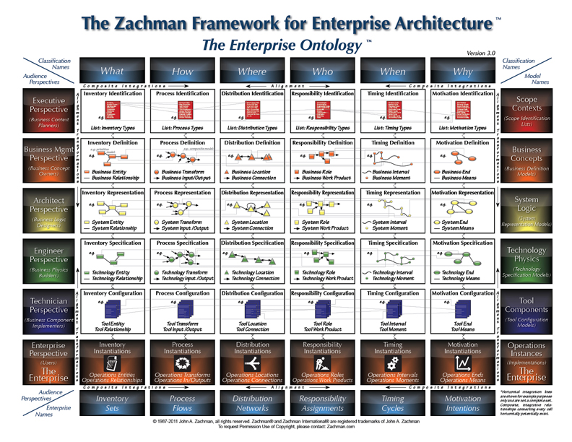

Slide 7
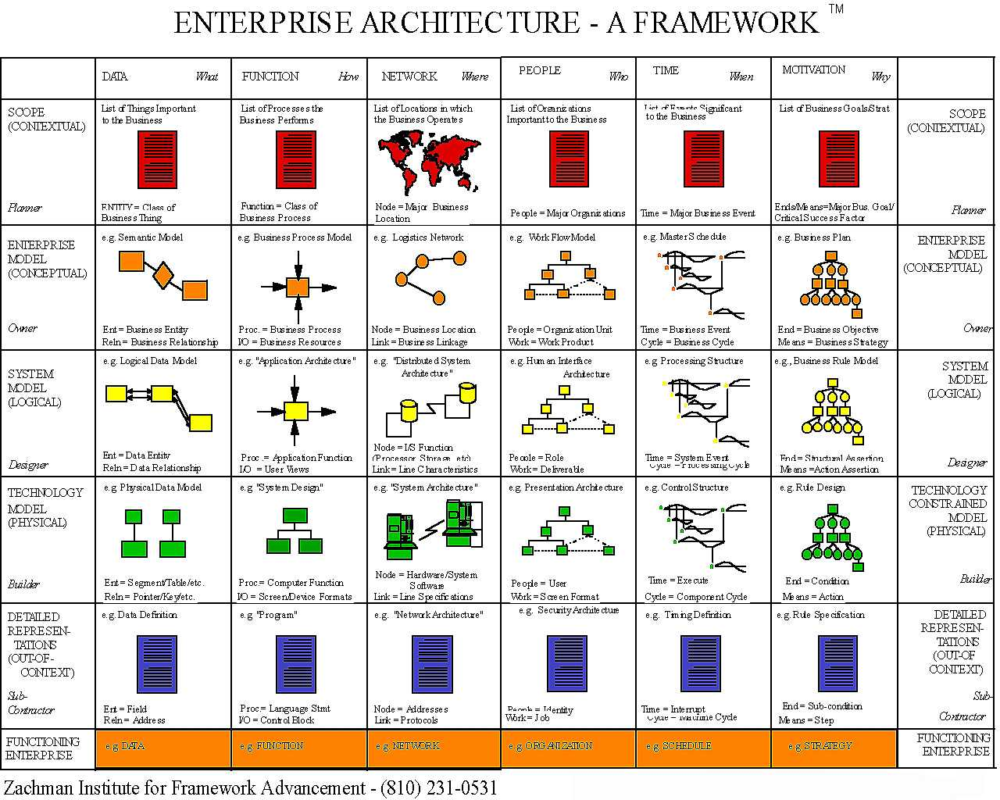
The Zachman Framework
Data What
Function How
Network where
People Who
Time When
Motivation Why
Scope
(Contextual)
Planner
Subject: Scope
Content: (Contextual)
Stakeholder: Planner
Business
(Conceptual)
Owner
Subject: Business
Content: (Conceptual)
Stakeholder: Owner
System
(Logical)
Designer
Subject: System
Content: (Logical)
Stakeholder: Designer
Technology
(Physical)
Builder
Subject: Technology
Content: (Physical)
Stakeholder: Builder
Components
(Detailed)
Sub-Contractor
Subject: Components
Content: (Detailed)
Stakeholder: Sub-Contractor
Enterprise
Subject: Real Working Enterprise

Slide 8
Challenges of using ZF
Engineering and reengineering perspectives from each other
Different languages and standards coming from different sources
Works have been done on:
Applying UML to ZF
Assigning MDA-based models to ZF

Slide 9
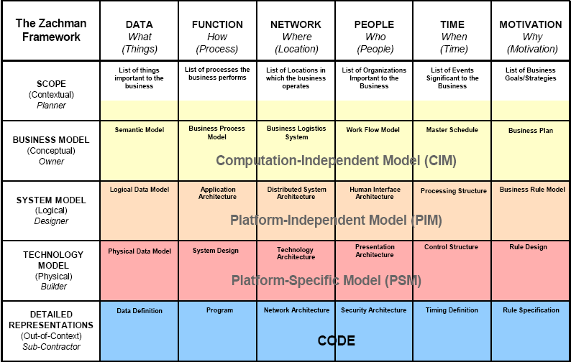
MDA vs. ZF: Separation of Concerns
http://www.omg.org/mda/mda_files/09-03-WP_Mapping_MDA_to_Zachman_Framework1.pdf

